Slide 1

BBA 4th Sem Session 2023-24 Startup Management Assignment 3
Submitted to: Shilpi Upadhyay
Submitted By: Shankh Bansal(AU22C1013)

Slide 2

Index
Introduction to Entrepreneurship
Developing Successful Business Ideas
Idea to Entrepreneurial Firm
Managing and Growing an Entrepreneurial Firm
Expansion

Slide 3
Unit 1 Introduction to Entrepreneurship
Entrepreneurship
Types of Entrepreneurships
Types of Start Up firms.

Slide 4

Entrepreneurship
Entrepreneurship is the ability and willingness to create, organize, and manage a business enterprise, including all of its uncertainties, in order to earn profit.
Business owners share many of the same entrepreneur characteristics: leadership, vision, discipline, curiosity, creativity, adaptability, and the ability to take measured risks.

Slide 5

Characteristics of Entrepreneurship
Economic Activity
Innovation
Risk
Teamwork
Profit

Slide 6

Types of Entrepreneurship
Small Business Entrepreneurships
Scalable startup Entrepreneurship
Social Entrepreneurship
Large company Entrepreneurship

Slide 7
Types of Start Up firms.
Salary Substitute Firm
Lifestyle Firm
Entrepreneurship Firm

Slide 8

Examples
In Assignment 1, our task was to initiate sustainable and eco-friendly startups. During this, we identified various issues in temples, including waste management and cleanliness. A startup targeting these challenges could be categorized as an Environmental Services startup, emphasizing sustainable waste disposal, cleanliness, and the implementation of eco-friendly practices within religious institutions.

Slide 9
Unit 2 Developing Successful Business Ideas
Recognizing Opportunities and Generating Ideas
Feasibility Analysis
Developing an Effective Business Model
Industry and Competitor Analysis
Writing a Business Plan

Slide 10

Recognizing Opportunities &Generating Ideas
Market Research: Understand market trends, customer needs, and potential gaps in the market.
Problem Solving: Identify problems or challenges that people face and consider how your business could provide solutions.
Innovation: Explore new technologies, processes, or business models that could disrupt existing markets.

Slide 11

Feasibility Analysis
Market Feasibility: Assess the demand for your product or service in the target market.
Technical Feasibility: Evaluate the technical requirements and challenges associated with your business idea.
Economic Feasibility: Estimate startup costs, operating expenses, and potential revenue streams.

Slide 12
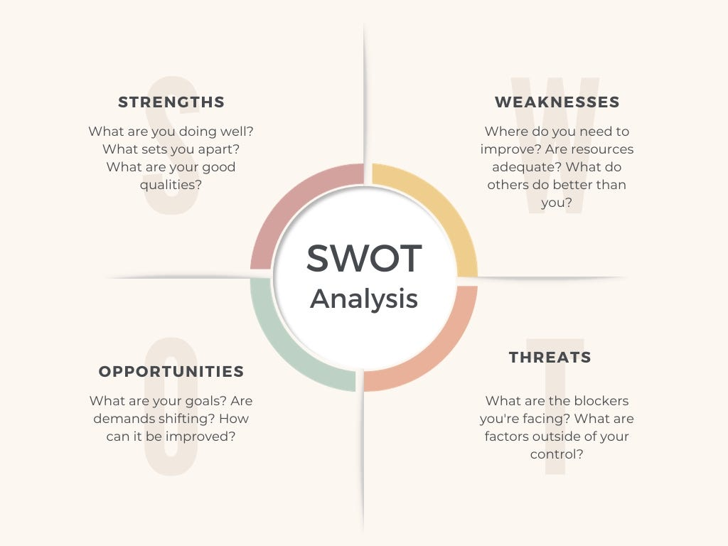
SWOT Analysis

Slide 13

Developing an Effective Business Model
Value Proposition: Clearly articulate what value your product or service offers to customers.
Revenue Model: Define how your business will generate income, whether through sales, subscriptions, licensing, etc.
Cost Structure: Identify and analyze the costs associated with running your business.
Customer Acquisition: Outline strategies for acquiring and retaining customers.

Slide 14
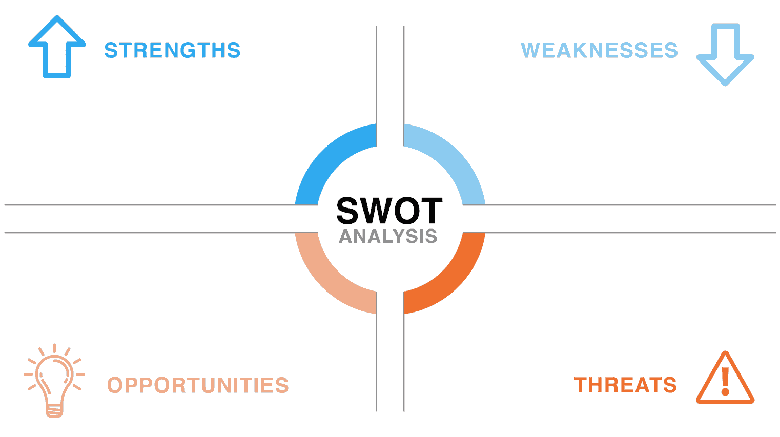
Long-Term Sustainability
Eco friendly
Respectful Approach
Implementation Support
Knowledge Sharing
Traditional Constraints
Lack of Resources
Limited Awareness
Inadequate Collaboration
Short-Term Focus
Krapa
Education & Awareness
Adapting Rituals
Symbolic Significance
Community Involvement
Cultural & Spiritual Guidance
Resistance to Change
Limited Resources
Knowledge and Awareness
Community Expectations

Slide 15
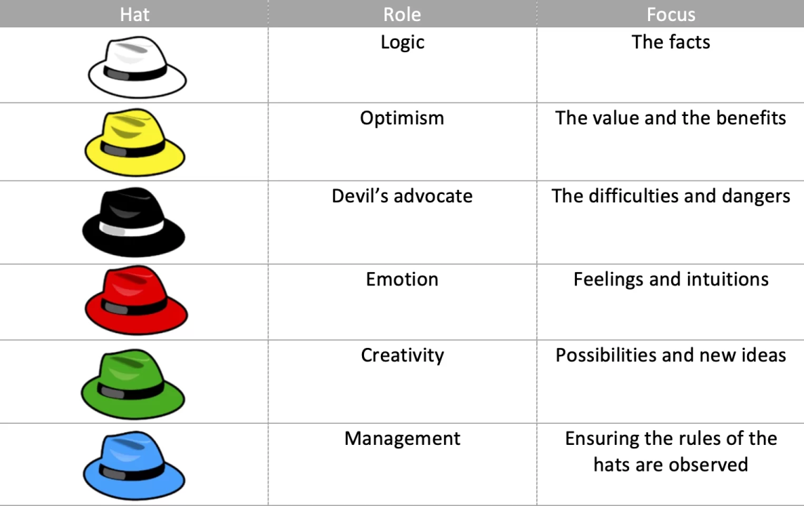
6 Thinking Hats

Slide 16

Industry & Competitor Analysis
Industry Analysis: Understand the broader industry trends, regulations, and potential challenges.
Competitor Analysis: Identify direct and indirect competitors, analyze their strengths and weaknesses, and find differentiators for your business.

Slide 17
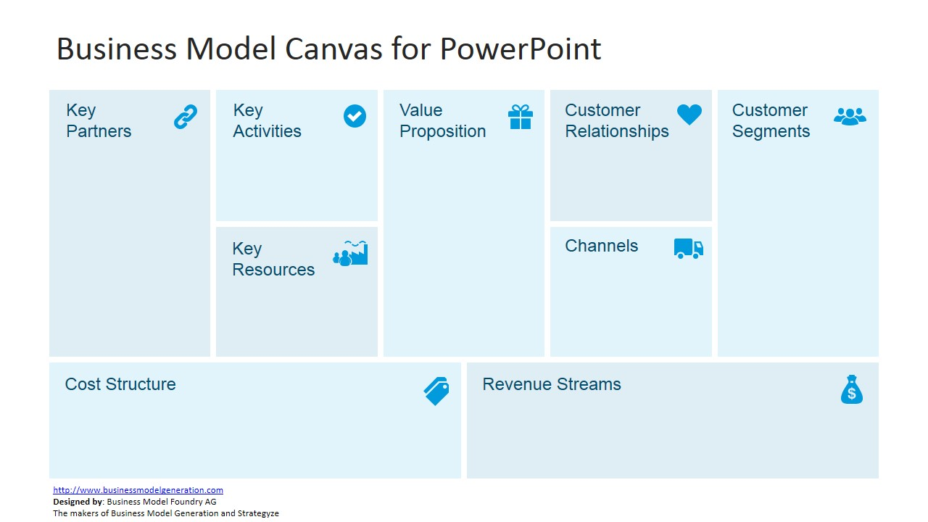
Supply Chain Development
Marketing
Production
HR Management
Temple
Household
Shopkeepers
Farmers
NGO
Eco Friendly
Best From Waste
Affordable
Employment Generation.
Feedback structure
Customer support
Temple
Farmers
Wholesalers
International Market
Digital Marketing
Wholesalers
Retails
B2B
NGO
Brand
Network of workers
Workshop
Packaging
Raw Material
Employee
Marketing
Packaging
Machinery
Maintenance
Warehousing
Technology
Sales

Slide 18
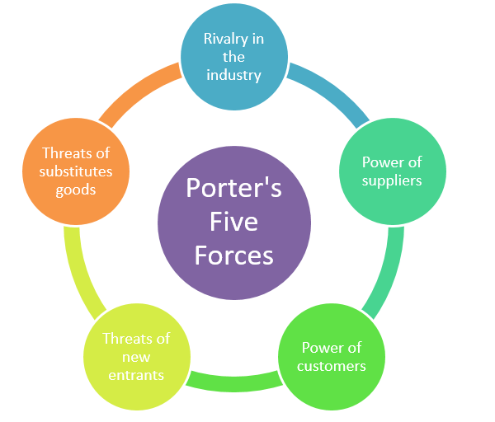
Porter's Five Forces Model

Slide 19
Unit 3 – Idea to Entrepreneurial Firm
Preparing the Proper Ethical and Legal Foundation
Assessing a New Venture’s Financial Strength and Viability
Building a New-Venture Team
Getting Financing or Funding

Slide 20

Preparing the Proper Ethical & Legal Foundation
Ethical Framework
Legal Essentials
Maintaining Compliance
Intellectual Property Protection

Slide 21

Assessing Financial Strength & Viability
Financial Planning - It involves the systematic process of creating a detailed roadmap for managing financial resources, making informed decisions, and achieving the financial goals of the business.
Risk Analysis - Identify potential financial risks and develop strategies to mitigate them. Assess market volatility, competitive threats, and economic factors that could impact your venture's financial health.

Slide 22
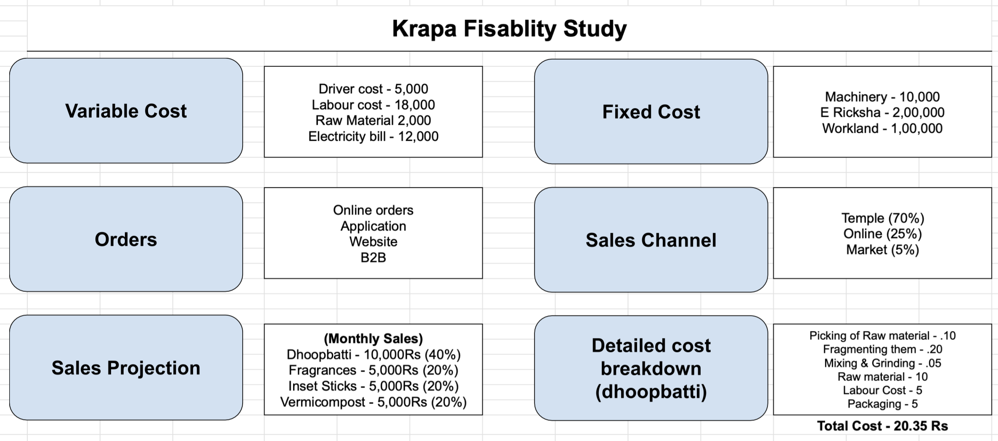

Slide 23
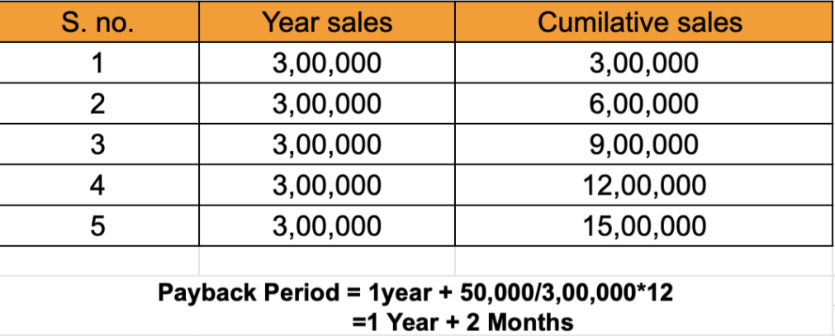
Payback Period
Total investment = Fixed cost + Variable cost = 3,50,000
Monthly sales = 25,000

Slide 24

Getting Financing or Funding
Bootstrapping
Debt Financing
Equity Financing

Slide 25
Unit 4 Managing and Growing an Entrepreneurial Firm
Unique Marketing Issues -The Importance of Intellectual Property
Preparing for and Evaluating the Challenges of Growth

Slide 26

Unique Marketing Issues -The Importance of Intellectual Property
Limited Budget
Brand Building
Digital Presence
Adapting to rapid change

Slide 27
Preparing for and Evaluating the Challenges of Growth
Operation scaling
Financial Management
Team dynamics
Market Expansion

Slide 28

Strategies for Firm Growth
Market Penetration
Product Development
Market Development
Diversification

